Slide 1

M57 Patents Data Leakage Investigation
Course: GOV07020NU24 – Conduct Advanced Forensic Investigations

Slide 2
Executive Summary
Forensic investigation of Jo Smith’s workstation and associated evidence
Objective: Identify source and method of patent data leak
Tools: Autopsy, FTK Imager, Volatility, Wireshark
Finding: Data exfiltration confirmed via email, not USB

Slide 3
Scope & Objectives
Purpose: Determine method, timeline, and extent of data leak
Evidence Sources:
jo-2009-12-10.E01 (disk)
jo-work-usb-2009-12-11.E01
jo_ram.mem
net-2009-12-10-12:00.pcap.gz
jo-email.pst
Goals: Who: Jo Smith | What: Patent documents | When: Dec 10–11, 2009 | How: Email

Slide 4
Tools & Methodology
Disk Analysis:
Memory Analysis
Network Analysis:
Integrity Verification:
Mounting Tools:
FTK Imager
Autopsy
Volatility
Wireshark
MD5
Ewf-tools
Loop devices
SHA1 hashes

Slide 5
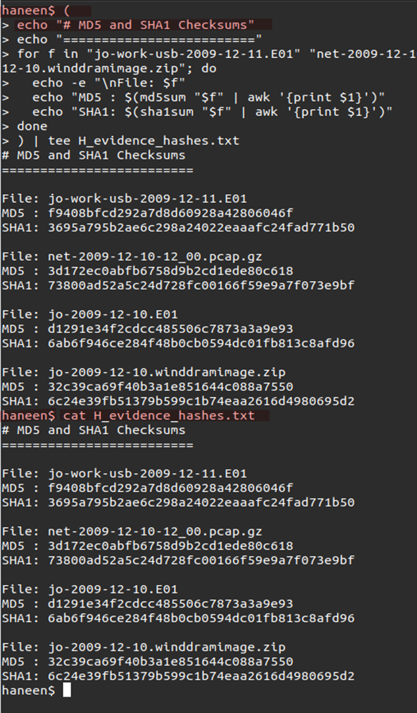
Evidence Handling & Integrity
Write-blockers used for forensic soundness
Hash values verified for all evidence (MD5 + SHA1)
Complete Chain of Custody maintained
Legally authorized analysis; personal data handled ethically

Slide 6
Hash Verification & Chain of Custody
Evidence File | MD5 Hash | SHA1 Hash
jo-2009-12-10.E01 | d1291e34f2cdcc485506c7873a3a9e93 | 6ab6f946ce284f48b0cb0594dc01fb813c8afd96
jo-2009-12-11.E01 | f9408bfcd292a7d8d60928a42806046f | 3695a795b2ae6c298a24022eaaafc24fad771b50
jo-2009-12-10.winddramimage.zip | 32c39ca69f40b3a1e851644c088a7550 | 6c24e39fb51379b599c1b74eaa2616d4980695d2
net-2009-12-10-12:00.pcap.gz | 3d172ec0abfb6758d9b2cd1ede80c618 | 73800ad52a5c24d728fc00166f59e9a7f073e9bf
Custody Summary:
All evidence downloaded from DigitalCorpora → verified → analyzed

Slide 7
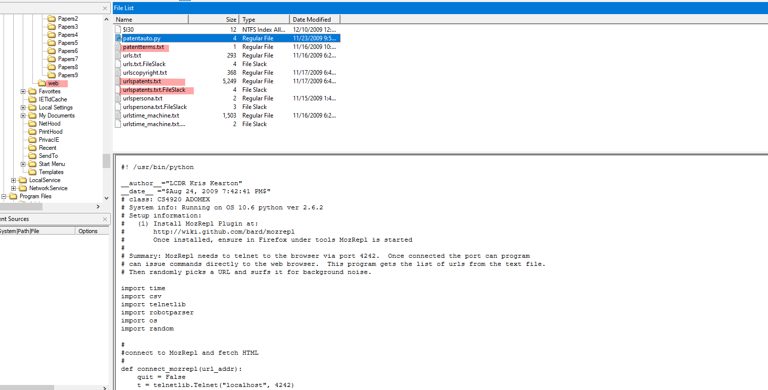
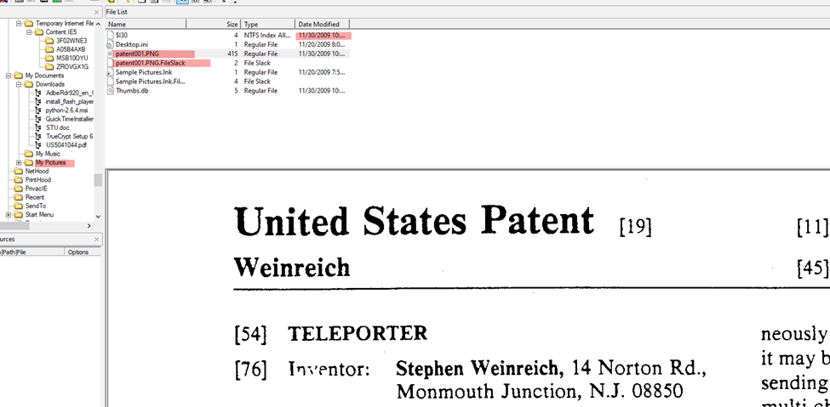
Disk Analysis (FTK Imager)
Patent-related folders found: Papers1–Papers17
Recovered deleted folders – mostly empty
Registry logs show USB usage (jo-work-usb-2009-12-11.E01)
No direct patent files transferred to USB

Slide 8
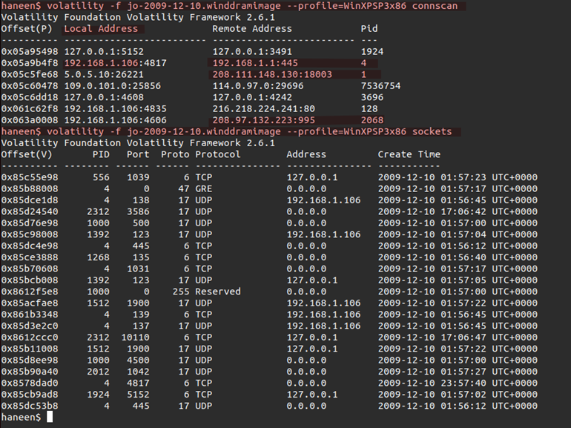
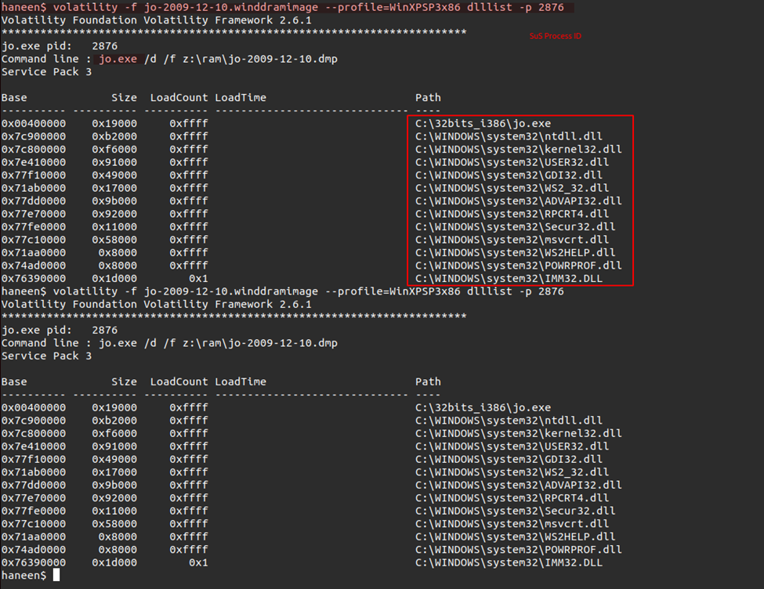
Memory Analysis (Volatility)
OS: Windows XP SP3
Suspicious processes: cmd.exe, jo.exe
Commands indicate copying data to Z:\ (USB)
Email client activity detected
Encrypted payload found in SMTP memory segment

Slide 9
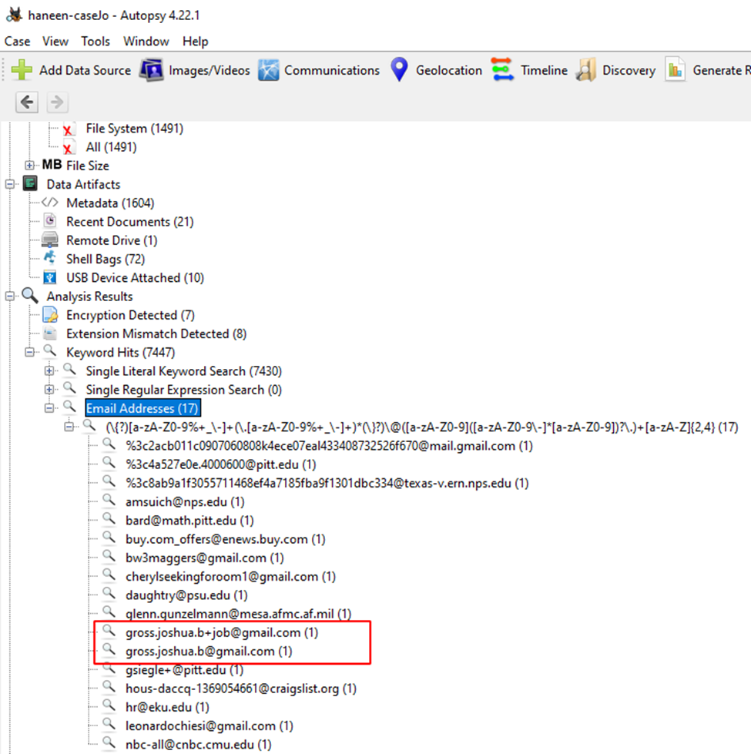
Email & Communication Analysis
External addresses found:
gross.joshua.b@gmail.com
gross.joshua.b+job@gmail.com
SMTP packet (1518 bytes) sent from Jo’s workstation
No USB evidence, but email exfiltration confirmed

Slide 10
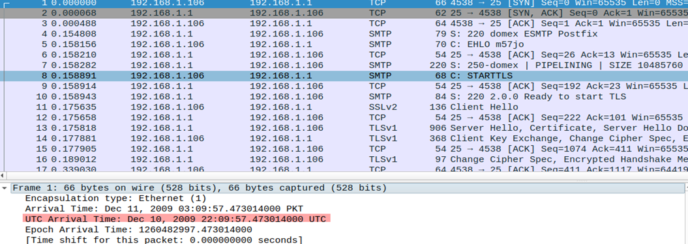
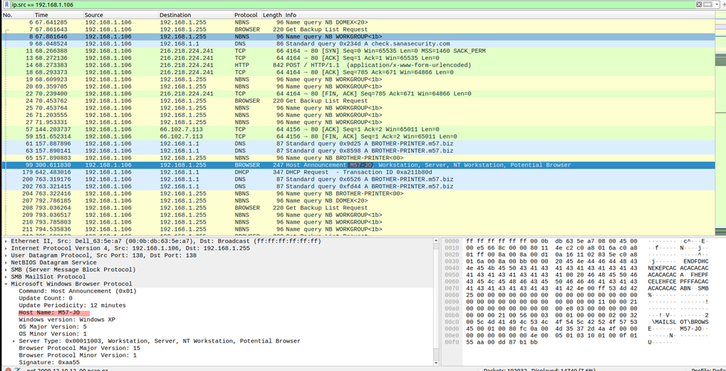
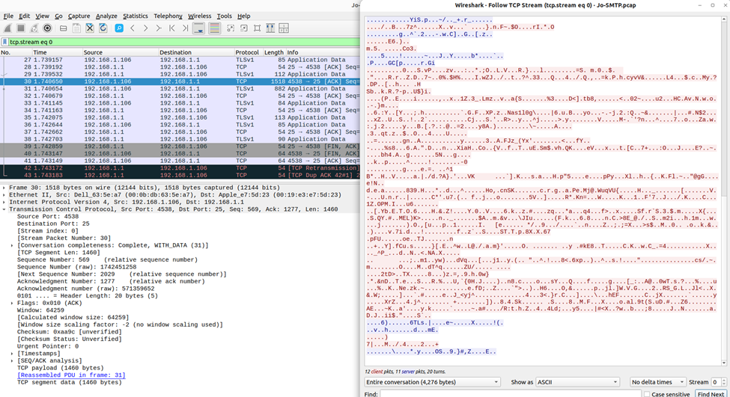
Network Analysis
Workstation IP:
192.168.1.106
Filters Used:
HTTP uploads
SMTP/FTP traffic
Non-standard protocols
Findings:
SMTP traffic with encrypted attachment
No large HTTP/FTP transfers → Email confirmed as vector

Slide 11
Timeline Reconstruction
Date/Time | Event | Source
09:12 | design_spec_v2.docx opened | Disk
09:12 | jo.exe executed | Memory
10:25 | USB activity logged | Disk
11:35 | External email sent | Email
03:09 | SMTP packet sent | Network
→ Data leak occurred around 03:09 UTC, Dec 10, 2009.

Slide 12
Findings Summary
Who:
What:
When:
How:
Jo Smith
Confidential patent design documents
Dec 10, 2009 (~03:09 UTC)
Email (SMTP, encrypted payload)

Slide 13
Conclusions
Data exfiltration confirmed via email
USB ruled out as primary method
Network artifacts support email leak
Encryption used (possible TrueCrypt involvement)

Slide 14
Recommendations
Implement Data Loss Prevention (DLP) tools
Restrict access to sensitive folders
Audit email attachments for confidential data
Monitor SMTP traffic for anomalies
Enforce encryption key management policies
Reflection
Enhanced understanding of evidence integrity & chain of custody
Learned practical forensic imaging and analysis (FTK, Volatility, Wireshark)
Challenge: Correlating timestamps and encrypted traffic manually

Slide 15
References

